Slide 1
HOLISTIC REHABILITATION
PROVIDE QUALITY OUTDOOR SPACES
PROVIDE BASIC AMENITIES
SENSE OF SAFETY
DIGNITY
MASTERPLAN
DUE CONSIDERATION TO FUTURE EXPANSION
ADDRESS CLIMATE CHANGE
MIXED USE SPACES
LONGEVITY
COMMUNITY
SHARED COMMUNAL FACILITIES
COMMON AREAS FOR COMMUNITY ACTIVITIES

Slide 2
HOLISTIC REHABILITATION
MAINTAIN THE QUALITY OF SPACES
THERMAL & VISUAL COMFORT
DIGNITY
DWELLING UNIT
DURABILITY OF CONSTRUCTION MATERIALS
CLIMATE RESPONSIVE
FLEXIBLE SPACES
LONGEVITY
COMMUNITY
INTERACTION WITH THE NEIGHBOURS
COMMON SERVICE CORES

Slide 3
-COURTYARDS
-PLAYGROUND
- WELLS, LOTUS PONDS
-MULTI-PURPOSE COMMUNITY SPACES
-RELIGIOUS SPACES
-CRECHE/PLAYSCHOOL
COMMUNITY SPACES
OPEN SPACES
DWELLING UNITS
150 Dwelling Units (DU)
1 DU /Family
-WATER SUPPLY
-RAINWATER HARVESTING – COLLECTION & STORAGE
-SEWAGE & WASTE DISPOSAL
-ELECTRICITY & RENEWABLE ENERGY
-GROCERY
-VEGETABLE
-STATIONARY
-PHARMACY
SERVICES
COMMERCIAL

Slide 4
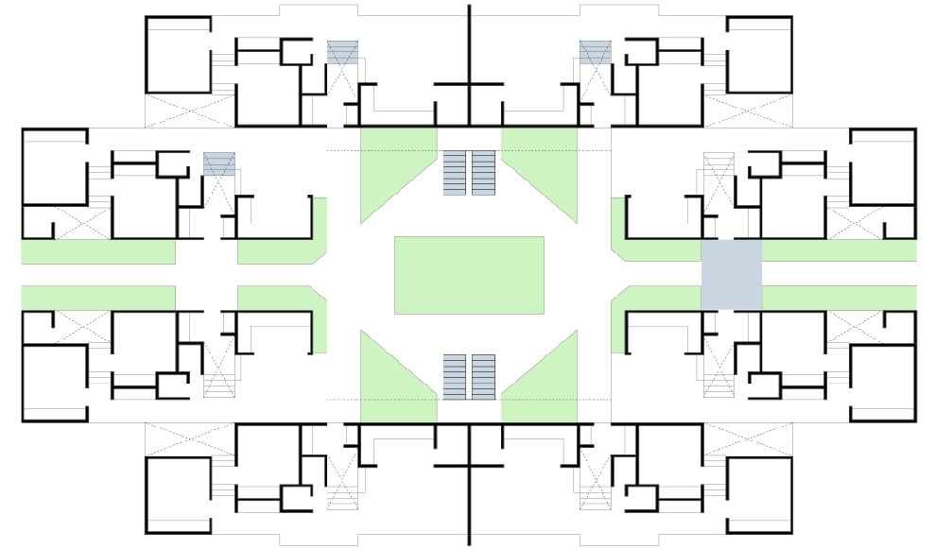
GROUND LEVEL
Cluster Footprint–8900 sqft
No. of Dwelling Units - 8
Service Core – 2 Nos.
Green Space - 1173 sq.ft (13%)
CLUSTER LAYOUT

Slide 5
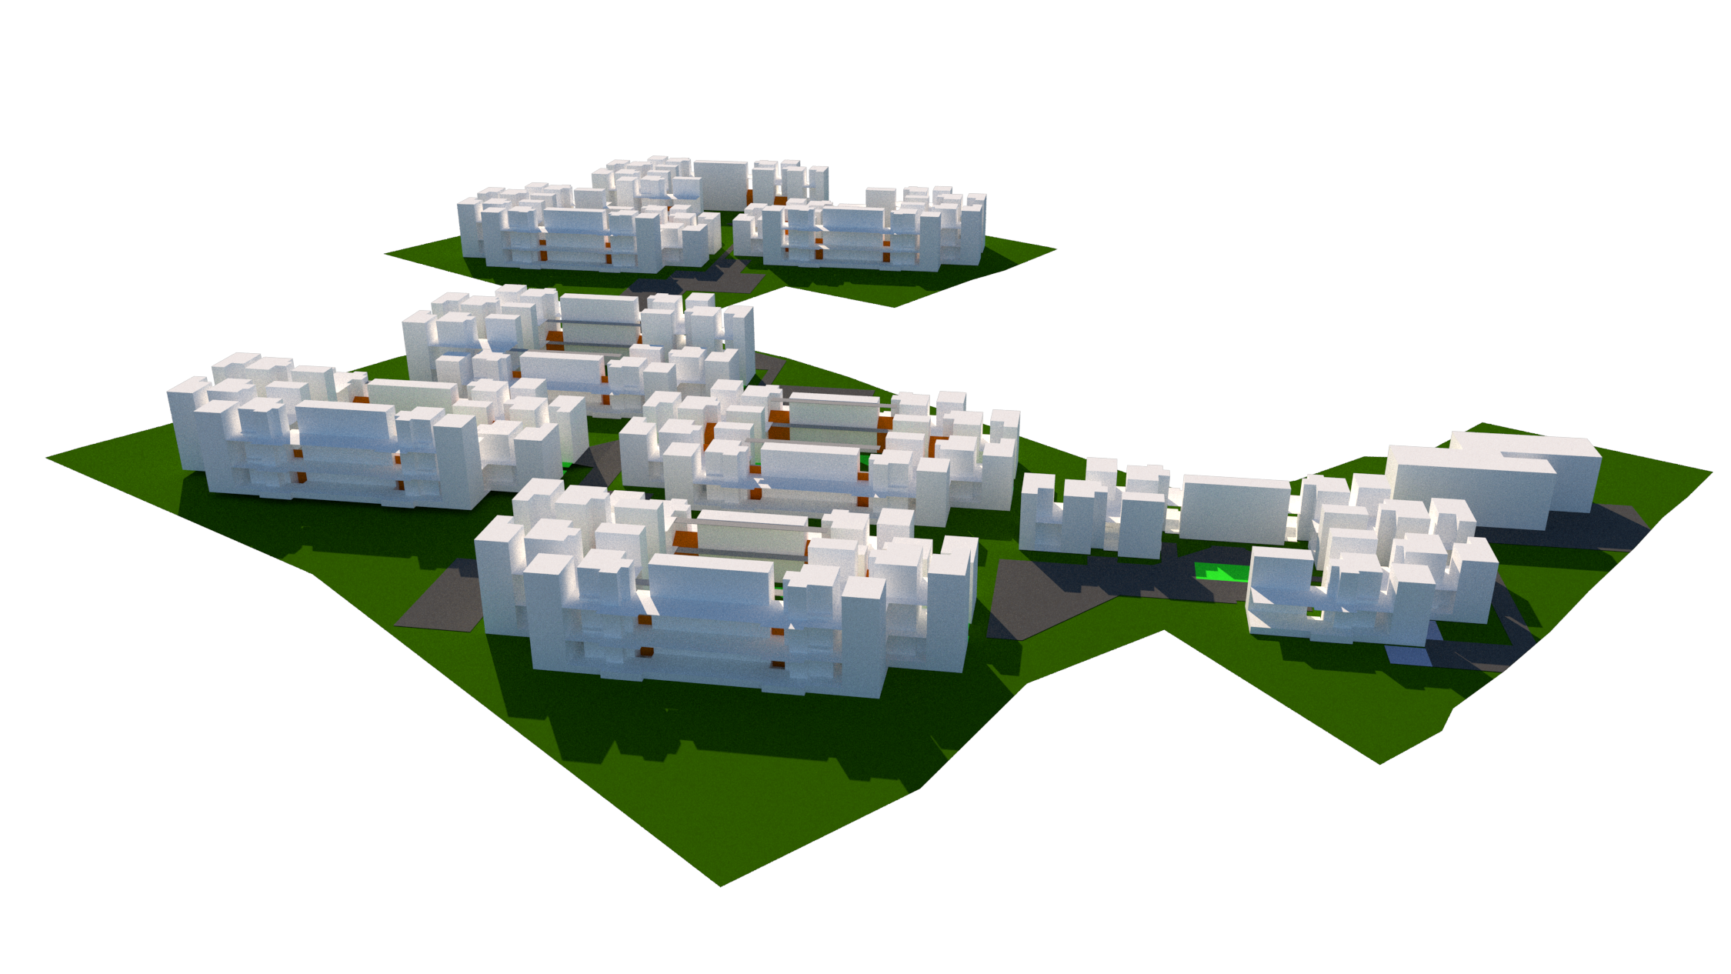
G+2 Units
G+1 Units
Central Open Spaces
Community Space
Service Core
Connecting Pathways
MASTERPLAN

Slide 6
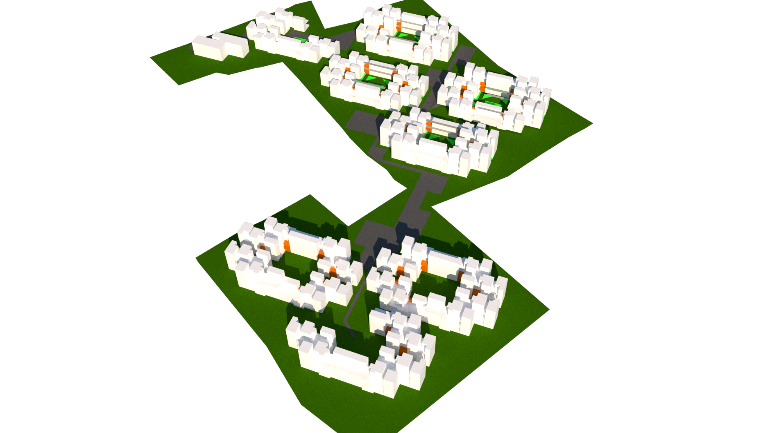
MASTERPLAN

Slide 7
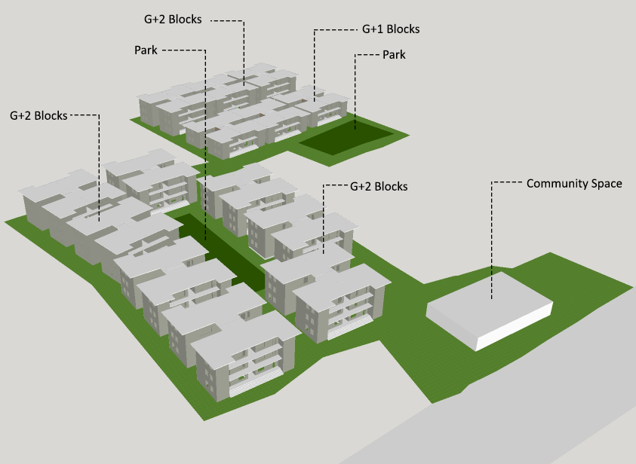
MASTERPLAN

Slide 8
Option 1 |  | Rapidwall Construction using GFRG units
Option 2 |  | Conventional Construction using AAC blocks
Materials and Cost comparison for 2 storey 1500 sqft building
Material/Item | Units | Option 1 | Option 2 | Saving in % (Option 1 over Option 2)
Cement | Tons | 16 | 32.55 | 51%
Steel | kg | 1800 | 2779 | 35%
Sand | cum | 20 | 83.37 | 76%
Granite | cum | 38 | 52.46 | 28%
Bricks | units | - | 57200 | -
GFRG Panel | sqft | 500 | - | -
Water | Liter | 50000 | 200000 | 75%
Labour | Mandays | 389 | 1200 | 68%
Construction Time | Days | 21 | 120 | 83%
Wt of Superstructure | Tons | 170 | 490 | 65%
Construction Cost | Lakh Rs | 13.25 | 18.27 | 27%
Source: A seminar Report on affordable mass housing by Suman Pati, 2013

Slide 9
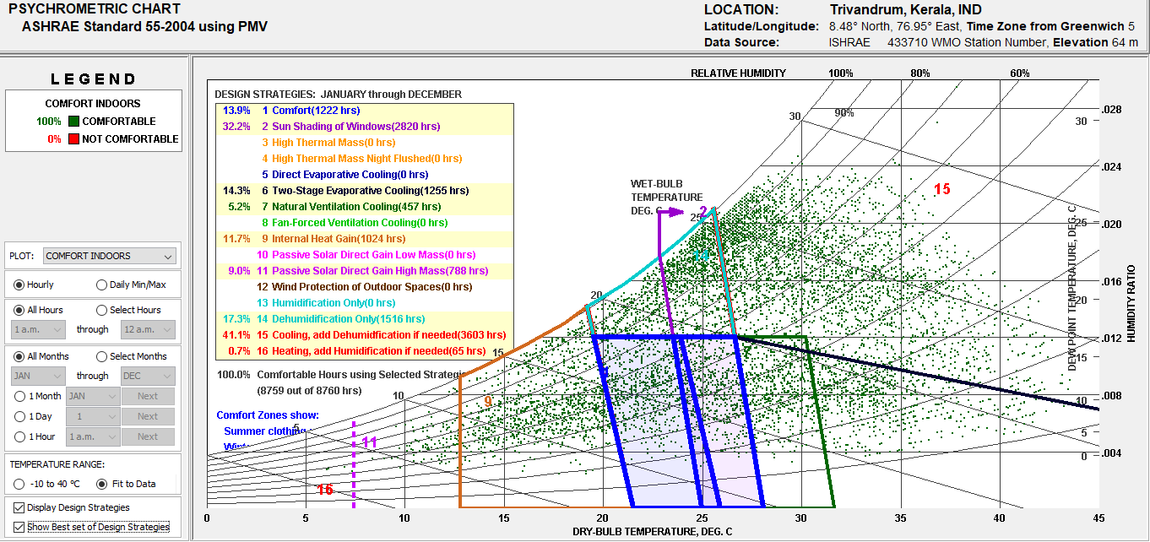
PASSIVE DESIGN
MINIMIZE SOLAR EXPOSURE (LONGER AXIS IN THE NORTH-SOUTH DIRECTION)
SHADING OF WINDOWS
NATURAL VENTILATION (OPERABLE WINDOWS & PROVISION FOR CROSS-VENTILATION)
USE OF CAVITY WALLS

Slide 10
WASTE
DISPOSAL
SEGREGATION OF WASTE
FOOD WASTE – COMPOSTING ON SITE
PAPER – (RECYCLE TO HAULER)
E-WASTE (RECYCLE TO HAULER)
SEWAGE
TREATMENT
OPTION 1- REED BEDS
OPTION 2 – BIO-DIGESTER
WASTE, WATER & ENERGY
UNDERGROUND COLLECTION TANK
PERCOLATION PIT TO BE INSTALLED ON SITE
REDUCE HARDSCAPE AREA
EFFICIENT STORMWATER DRAINAGE DESIGN
RAINWATER HARVESTING
RENEWABLE
ENERGY
OPTIMIZE DESIGN TO REDUCE ENERGY CONSUMPTION
UTILIZE ROOFS FOR SOLAR PV’S

Slide 11
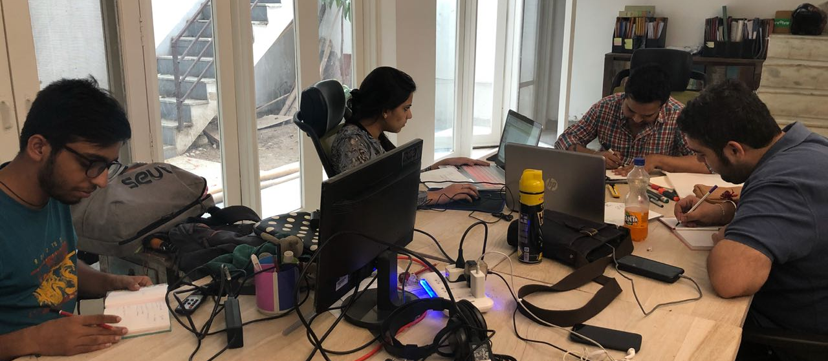
ANURAG BISWAS
ARCHITECT/GREEN BUILDING ANALYST
CHANDRIKA NATH
ARCHITECT
SOURAV BANERJEA
URBAN DESIGNER/ACADEMICIAN
AKSHAY DUA
ARCHITECT
TEAM 1

Slide 12
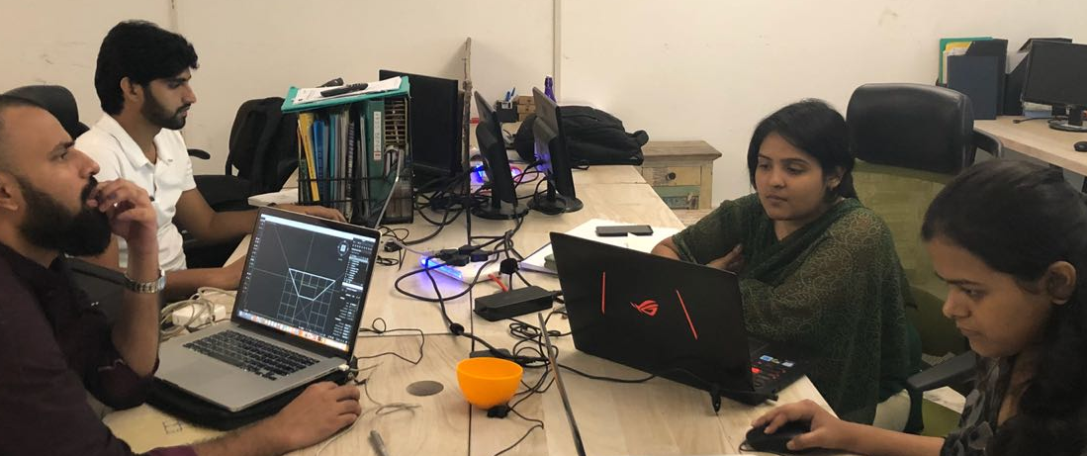
ABU TALHA FAROOQI
HEALTHCARE ARCHITECT/ ACADEMICIAN
MOHD. MUSTKEEM
ARCHITECT
SREELAKSHMI HARIDAS
GREEN BUILDING ANALYST/ ARCHITECT
ANKITA RANI
ARCHITECT
TEAM 2

Slide 13
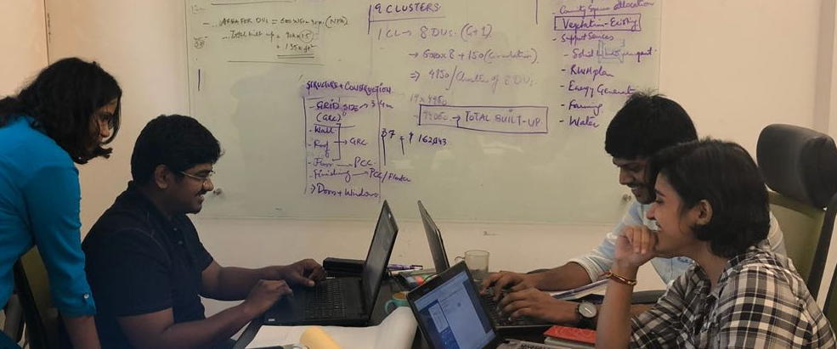
MEGHA MITTAL
ARCHITECT/GREEN BUILDING CONSULTANT
HARI PRASATH
ARCHITECT/GREEN BUILDING ANALYST
TARUN KUMAR
PURSUING B.ARCH
ANUSHMA MALPANI
ARCHITECT/GREEN BUILDING ANALYST
TEAM 3

Slide 14
Thank You

